Slide 1
Continuous Deployment on Microsoft Azure
Author: Duc Lai Trung Minh
Leader of External Communication
Microsoft Student Partners Vietnam

Slide 2
AGENDA
Azure in brief
Continuous Deployment
Demo
Resource

Slide 3
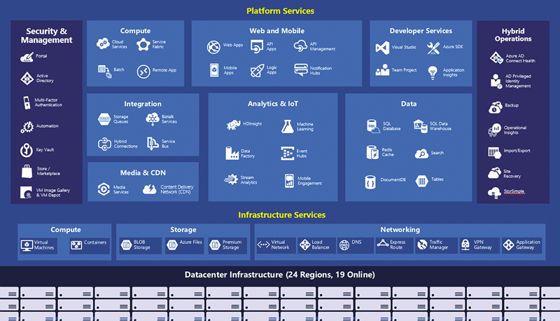
What is Azure?

Slide 4
What is the Continuous Deployment?
Imagine: Making a Website with NodeJS, PHP, JavaScript, ASP.NET
→ Deploy it with FTP or Visual Studio
Issues:
Forgot to copy files
Lazy of remembering too much FTP password
Need to deploy one source on many web-hosting
Many people working on the team project and need to control the deployment.

Slide 5
What is the Continuous Deployment?
Solution
When you commit the code to the repository source control (Git, GitHub, BitBucket, VSTS,…) → This one will deploy for you or generate the report if you build failed.
➔ Best way to manage the deployment

Slide 6
DEMO
GitHub + Azure Web App
Reference: https://docs.microsoft.com/en-us/azure/app-service/app-service-continuous-deployment

Slide 7
Resources
Visual Studio Team Services: Build and Releases
Azure Kudu: File Manager + Task Manager
Deploy WordPress on Azure in MS Imagine in 1-line:
https://github.com/MINHDUC1996/AzureScript-WordPress

Slide 8


